Slide 1
Introduction to Formal Verification
Ramesh, S.

Slide 2
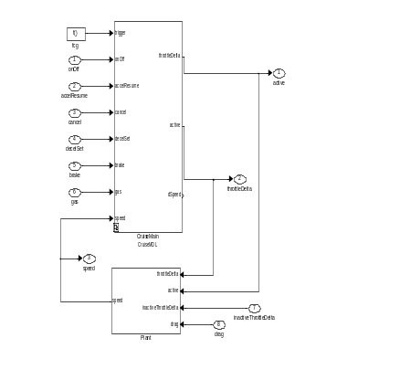
Formal Verification
Formally check,
a formal model of the system/component against
a formal specification
Properties
SL/SF Model
Proof/
Counter-
example
Verification Engine

Slide 3
3-Step Process
The steps are
  Formal Specification
  Formal Models
  Verification
Formal specification
  Precise statement of properties
  System requirements and environmental constraints
  Logic - PL, FOL, temporal logic
  Automata, labeled transition systems

Slide 4
Other Steps
Models
  Flexible to model general to specific designs
  Non-determinism, concurrency, fairness,
  HLL, Transition systems, automata
Verification
  Checking that model satisfies specification
  Static and exhaustive checking
  Automatic or semi-automatic

Slide 5
An Example (SW)
function gcd(x,y)
{
\*assume: x > 0 & y >0 & x=a & y=b *\
while (x<>y)
{ if x>y then x=x-y else y=y-x
}
\*assert: gcd(x,y) = gcd(a,b) */
}

Slide 6
GCD Example (contd.)
Specification
  Assume and Assert Conditions
  environment constraints and requirements
Model
  HLL code with precise semantics
Verification
  Symbolic Execution
  Theorem Proving

Slide 7
A more realistic example
struct RCD3_data { double X, Y; };
void get_inputsXY(struct RCD3_data *final_data)
{ ret1 = read_from_reg( 1, &InputX );
/*postfunc ( InputX >= 0 /\ InputX <= 4095 ) end*/
change_to_v(InputX, input_src, &tempX );
/*assert !(tempX < 0 \/ tempX > 5) end*/
final_data->X= tempX;
convert_to_d(1, tempX, final_data);
/*post (#X final_data >= -180) /\ (#X final_data <= 180)
end*/
}

Slide 8
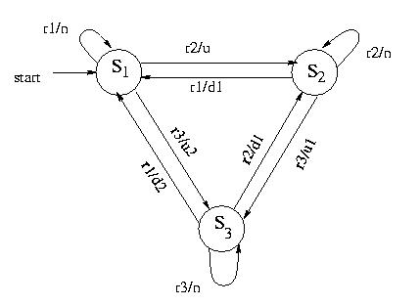
A Discrete Controller example
3- floor elevator controller,
S_{i} - in floor i
ri - request from floor I
U,d – up or down movement

Slide 9
Lift Controller (contd.)
Specification
  When the lift is in motion door is closed
  Every call is eventually attended
  The lift is busy attending one of the requests
  Safety and Liveness Properties
Verification
  State space exploration
  Model Checking
  Automatic

Slide 10
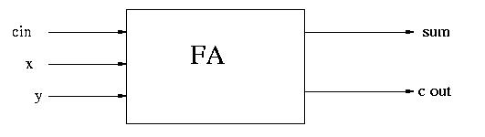
Third Example (HW)
Specification:
sum := (x ⊕ y) ⊕ cin
cout := (x ∧ y) ∨ ((x ⊕ y) ∧ cin)

Slide 11
Full Adder (Contd.)
Model
  Mathematical description of an implementation of full adder, say, a network of NAND gates
  Again a Boolean expression which involves additional internal variables
Verification
  Comparision of boolean expressions
  Equivalence Checking/SAT solving

Slide 12

FV Features
Math based Analysis techniques
  Deductive, Symbolic, Algorithmic
Static Analysis
  Contrast with dynamic analysis technique
Property-based verification
  Properties come from requirements
  Reachability, Stability, Mutual exclusion, etc.

Slide 13

FV Limitations
FV provides a piece of a solution to the problem of building reliable systems
Provides evidence for reliability
Enhances confidence
Many other pieces important
  Safety, security, fault-tolerance

Slide 14
Verification Vs Validation
Verification: `System is developed correctly’
Validation: `Correct system is developed’
Both Vs are essential for a product/system
Developing consistent and complete requirement for even simple system is challenging

Slide 15
Some Observations
Precise statement of requirements and constraints
  Nothing in the head, one has to commit
  No ambiguity, no escape
Precise description of Designs
Algorithmic or semi-automatic and rigorous techniques for verification

Slide 16
Observation (contd.)
Verification fails
  Specification can be wrong or incomplete
  Design could be too abstract
  Design is buggy and hence does not satisfy the specification
Verification succeeds
  if specification is trivial
  if specification derived from code
  if design meets specification

Slide 17
Formal Specification
Thorough review of Specification essential
Specification independent of design
Additional Step
Better done before the design starts

Slide 18
Further Observation
FV complicates the problem
Creates more work
No, not at all
  Traditional approaches ignores
  FV unearths the inherent problems
Definitely more work
  High quality does not come free!

Slide 19
Formal Verification Techniques
Three major techniques
  Equivalence checking (HW)
  Model checking(HW & SW)
  Theorem proving(HW & SW)
    Satisfiability Modulo Theories

Slide 20
Equivalence Checking
Checking equivalence of two similar circuits
Useful for validating optimizations, scan chain insertions
Comparison fo two boolean expressions – use of BDDs
Highly automatic and efficient
Most used formal Verification technique
Commercial tools :
  Design VERIFYer (Chrysalis Inc.)
  Formality (Synopsis, million gates in less than an hour)
  V-Formal

Slide 21
Model Checking
Another promising automatic technique
Checking design models against specification
Specifications temporal properties and environment constraints; use of temporal logic or automata
Design models are automata or HDl sub sets
Checking is automatic and bug traces
Very effective for control-intensive designs and Protocols
Many Commercial and academic tools:
Spin (Bell Labs.), PVS (SRI), STeP, VIS (UCB),
In-house tools: Rule Base (IBM), Intel, SUN, Bingo (Fujitsu), etc

Slide 22
Theorem Proving
Most Powerful technique
Specification and design are logical formulae
Checking involves proving a theorem
Semi-automatic
High degree of human expertise required
Mainly confined to academic
Number of public domain tools
  Nqthm, STeP, PVS, HOL

Slide 23
SMT Solving
A sub class of theorem proving techniques
  Quantifier-free logical formulae satisfaction
Common place technique recently
Solvers with various theories
  Theory of linear arithmetic, bit vectors, arrays, uninterpreted functions etc.
  Yices (SRI), Z3 (Microsoft)

Slide 24
Formal verification (experiences)
  Very effective for small control-intensive designs-blocks of hundreds of latches or state bits
  Many subtle bugs have been caught in designs cleared by simulation or testing
  Strong theoretical foundation
  High degree of confidence
  Holds a lot of promise
  Requires a lot more effort and expertise
  Large designs need abstraction
  Many efforts are underway to improve

Slide 25
Systems verified
Various microprocessors (instruction level verification):
  DLX pipelined architectures, AAMP5 (avionics applications), FM9001 (32 bit processor), PowerPC
Floating point units:
  SRT division (Pentium), recent Intel ex-fpu, ADK IEEE multiplier, AMD division
Multiprocessor coherence protocols
  SGI, sun S3.Mp architectures, Gigamax, futurebus+
Memory subsystems of PowerPC
Fairisle ATM switch core

Slide 26
Recent Successes
Device Drivers (Microsoft)
Small Operating Systems
Blockchain protocols
Design of large computer networks

Slide 27
State of the art
~ 500 registers (5K latches and 1000 combinational variables
Equivalence checking : ~ million gates designs
Simulation : million gates capacity
Various tools available
  Intel, Fujitsu, IBM, Motorola have in-house tools
  Commercial tools
    Abstracts HW (check-off of Siemanns), chrysalis, Formal Check, Vformal, frontline, view logic.
  Public domain tools:
    SMV, VIS, STE, SPIN, PVS, STeP, HOL

Slide 28
FV for Automotives
Very challenging in General
  Specification and Model Generation
  State Space Explosion, lack of integrated tool-chain
Automotive-specific Problems
  Infinite state
  Hybrid System
  Distributed system
  Multi-party components
  Fault-tolerance

Slide 29
References
  E.M. Clarke, O. Grumberg and D. Peled, Model Checking, MIT Press, 1999.
  C. Kern and M.R. Greenstreet, Formal Verification in Hardware Design: A Survey, ACM TODAES, 1999.
  R. Kurshan, Computer - Aided Verification of Co-ordinating Processes, Princeton Univ.Press, 1994
  Z. Manna and A. Pnueli, Temporal Specification and Verification of Reactive Systems Vol. I and II, Springer 1995.
  K. L. McMillan, Symbolic Model Checking, Kluwer 1993.

